Slide 1


Dibimbing.id | Digital Skill Fair 40.0 | Portofolio
Data Cleaning
Missing Value & Duplicate Check
Beauty Product Dataset Overview

Slide 2
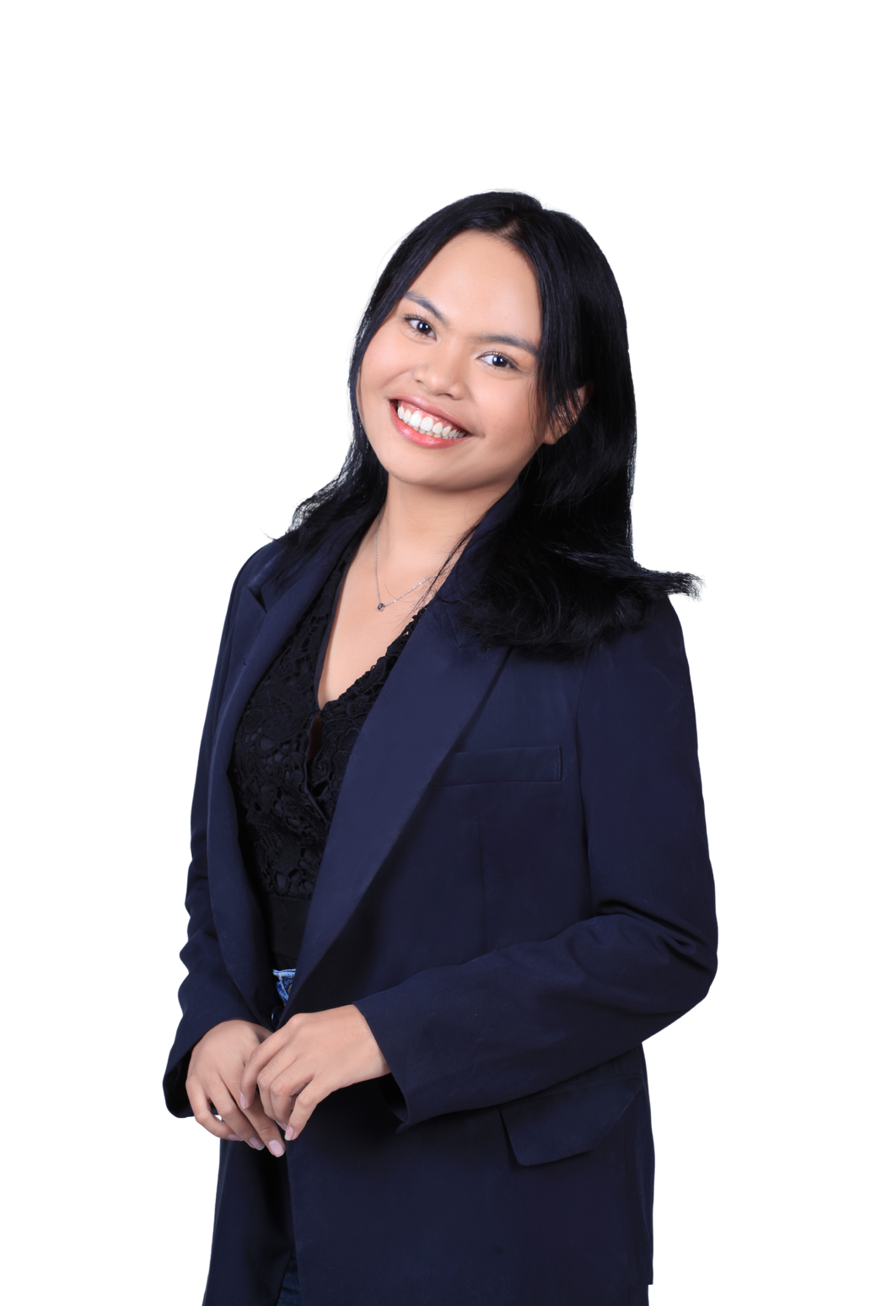
Dibimbing.id | Digital Skill Fair 40.0 | Portofolio
Hi! I’m Jessica Agnesia Tataung, a recent Pharmacy graduate passionate about data.
I’m detail-oriented, a quick learner, and communicate well in team settings. Currently, I’m developing skills in data analysis using Python and Excel.
Jessica Agnesia Tataung

Slide 3

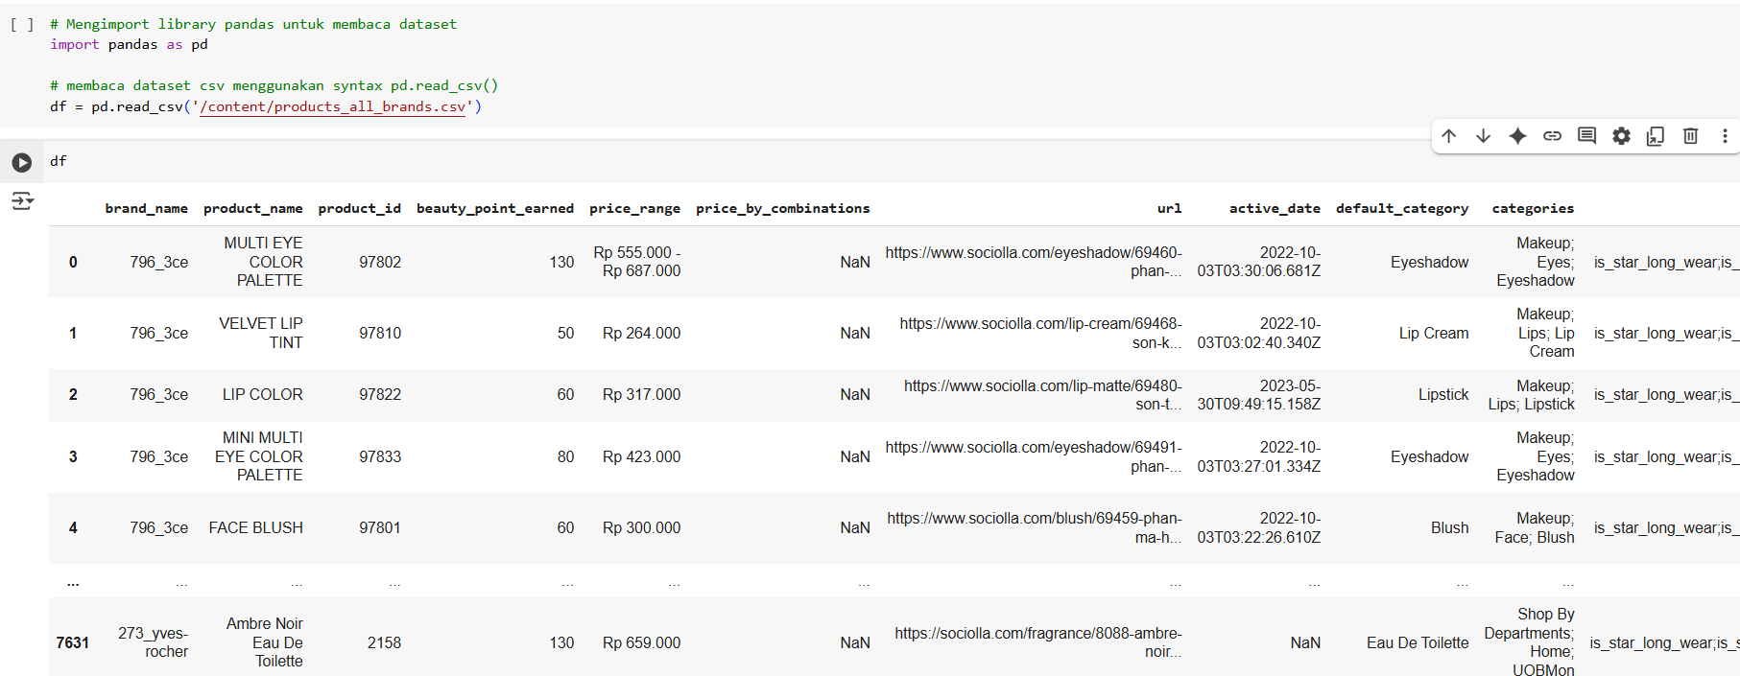
Dibimbing.id | Digital Skill Fair 40.0 | Portofolio
Data cleaning steps
Importing Libraries and Loading the Dataset
Code
result

Slide 4
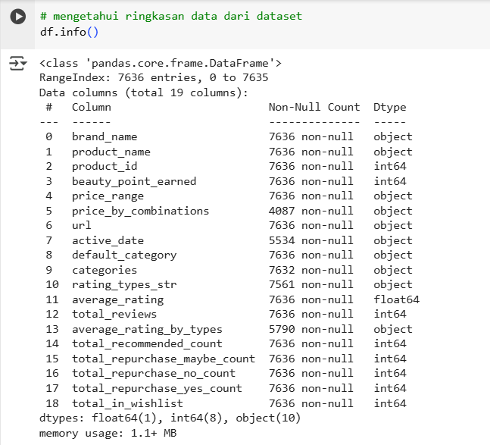
Dibimbing.id | Digital Skill Fair 40.0 | Portofolio
2. Initial Data Inspection
Code
DATASET OVERVIEW
result
1
Total rows = 7,636
2
Total coloums = 19
3
Focus = detecting missing values and duplicates
Source = Kaggle - Beauty product listing dataset
4

Slide 5

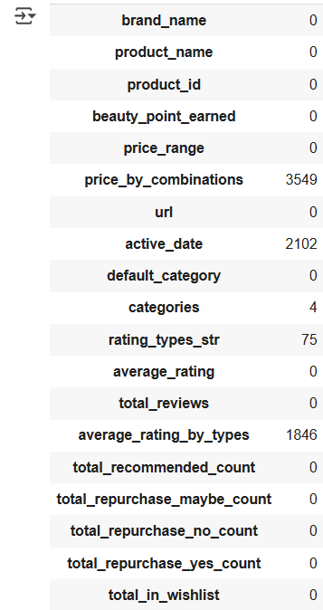
Dibimbing.id | Digital Skill Fair 40.0 | Portofolio
Code
3. Missing Value Analysis
DATA CONDITION : MISSING VALUES
result
1
Price_by_combinations = 3,549 missing
2
Active_date = 2,102 missing
3
Average_rating_by_types = 1,846 missing
4
Rating_types = 75 missing
5
Categories = 4 missing

Slide 6
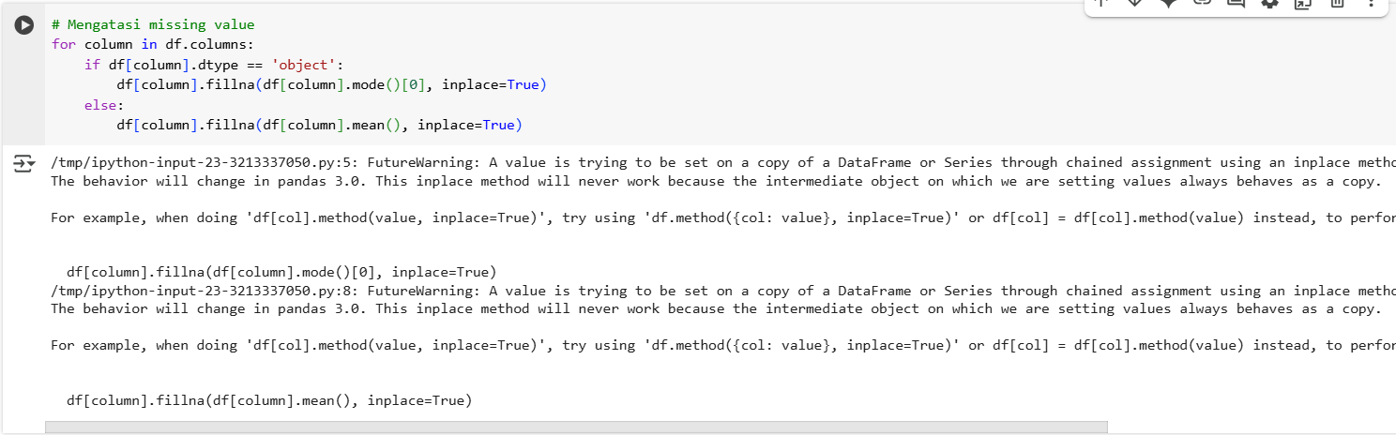
Dibimbing.id | Digital Skill Fair 40.0 | Portofolio
4. Handling missing value
Code
result

Slide 7
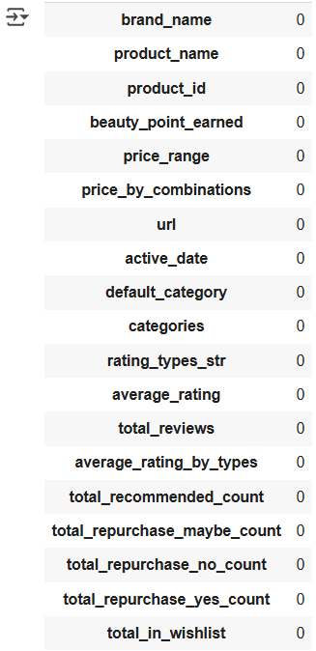

Dibimbing.id | Digital Skill Fair 40.0 | Portofolio
result
5. Check missing value after handling missing value
Code
Following the data cleaning process, the dataset contains no missing values

Slide 8
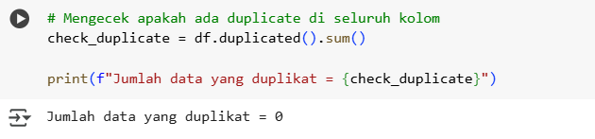
Dibimbing.id | Digital Skill Fair 40.0 | Portofolio
6. Duplicate Row Handling
After checking the dataset, no duplicate records were found. Additionally, data cleaning for missing values and duplicates has been successfully completed. As a result, the dataset is now clean and ready for further analysis
Code
result

Slide 9

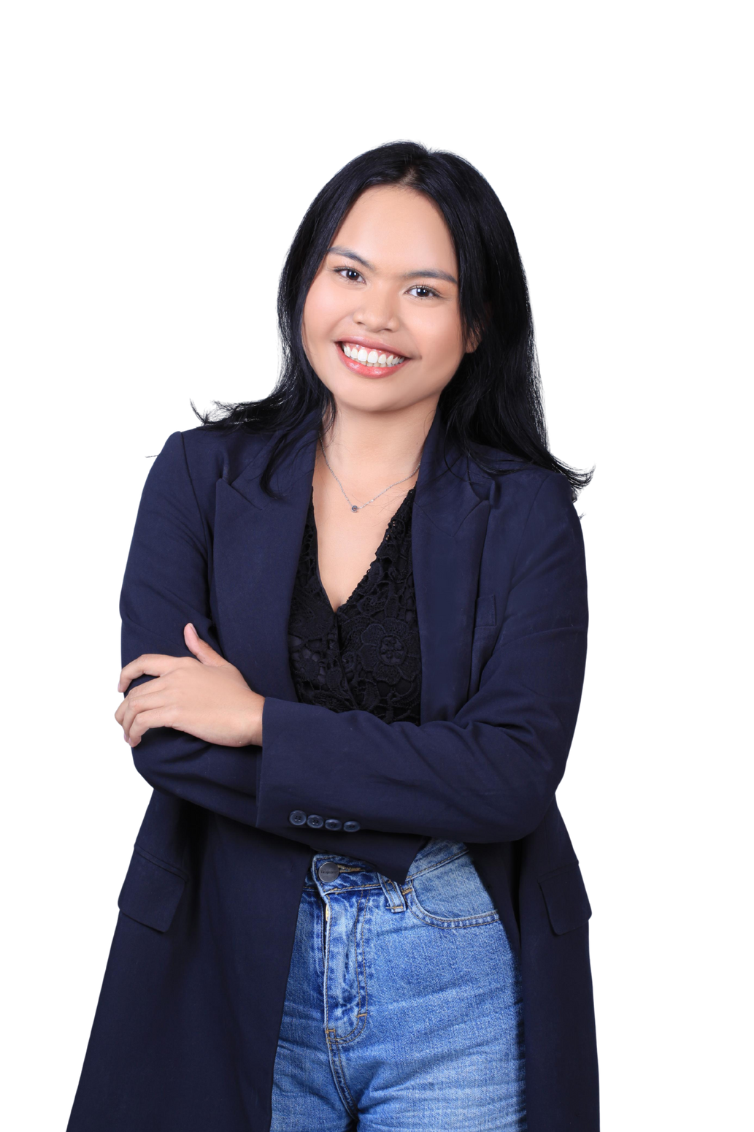
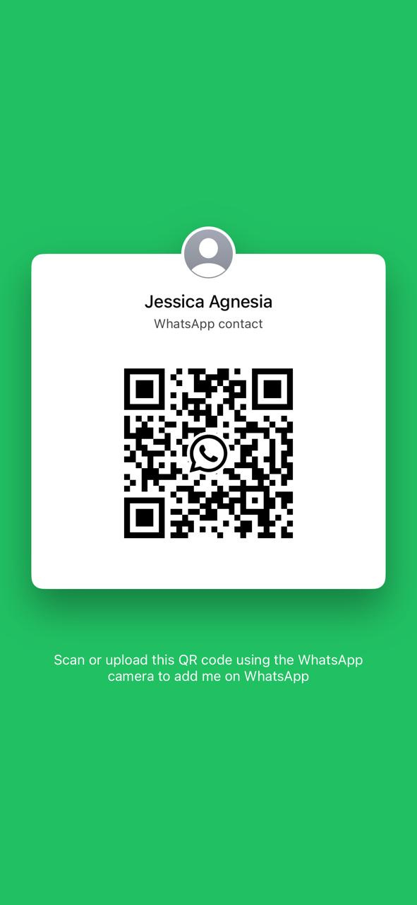


Dibimbing.id | Digital Skill Fair 40.0 | Portofolio
Let’s stay connected!
I’d love to hear your thoughts or collaborate on something exciting
www.linkedin.com/in/jessicaagnesiat
jessicaagnesiat@gmail.com
Reach me easily
Just scan this WhatsApp code
+62895351100201

